Slide 1
Since last we met…
George Michaelson
Geoff Huston
APNIC Labs
November 2015

Slide 2
The June 2015 Ad Campaign
Flash Only
No TLS support
Almost no Mac Support
Almost no Mobile support
Used FreeBSD + metal measurement platforms
Mostly Windows systems, with a smattering of Android, and a small amount of Mac OS X and iOS

Slide 3
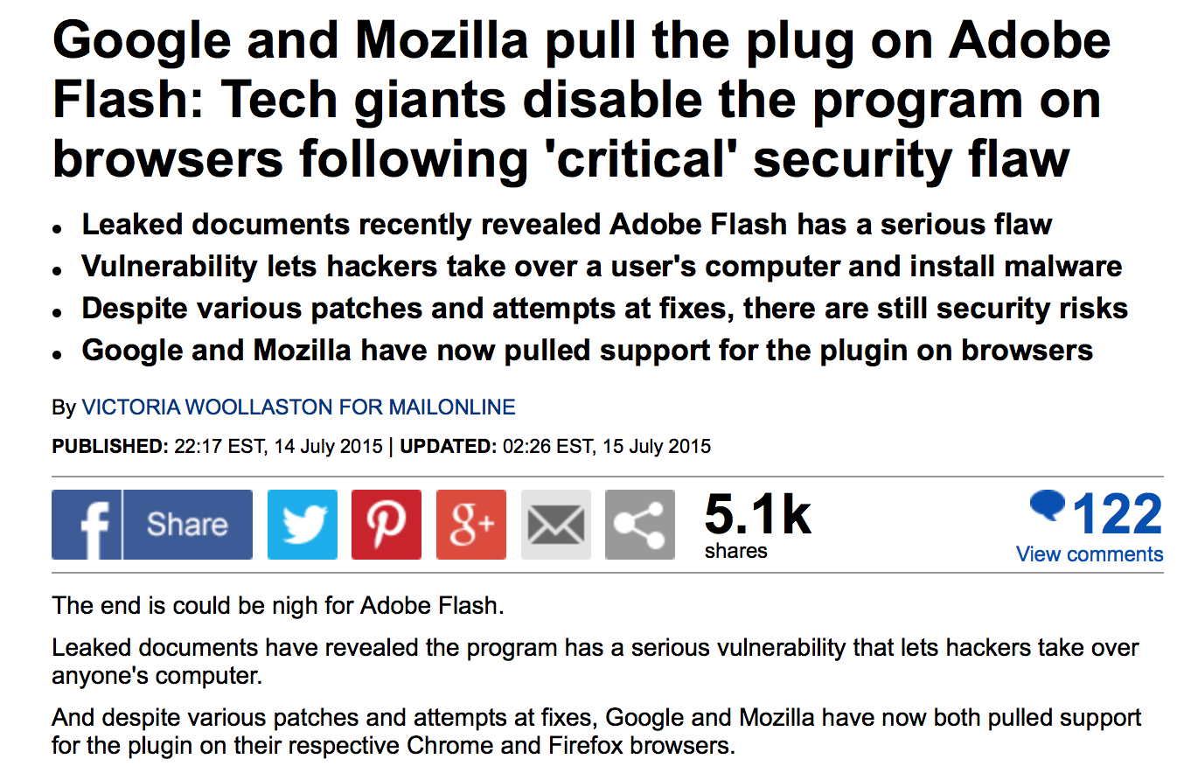
RIP Flash

Slide 4
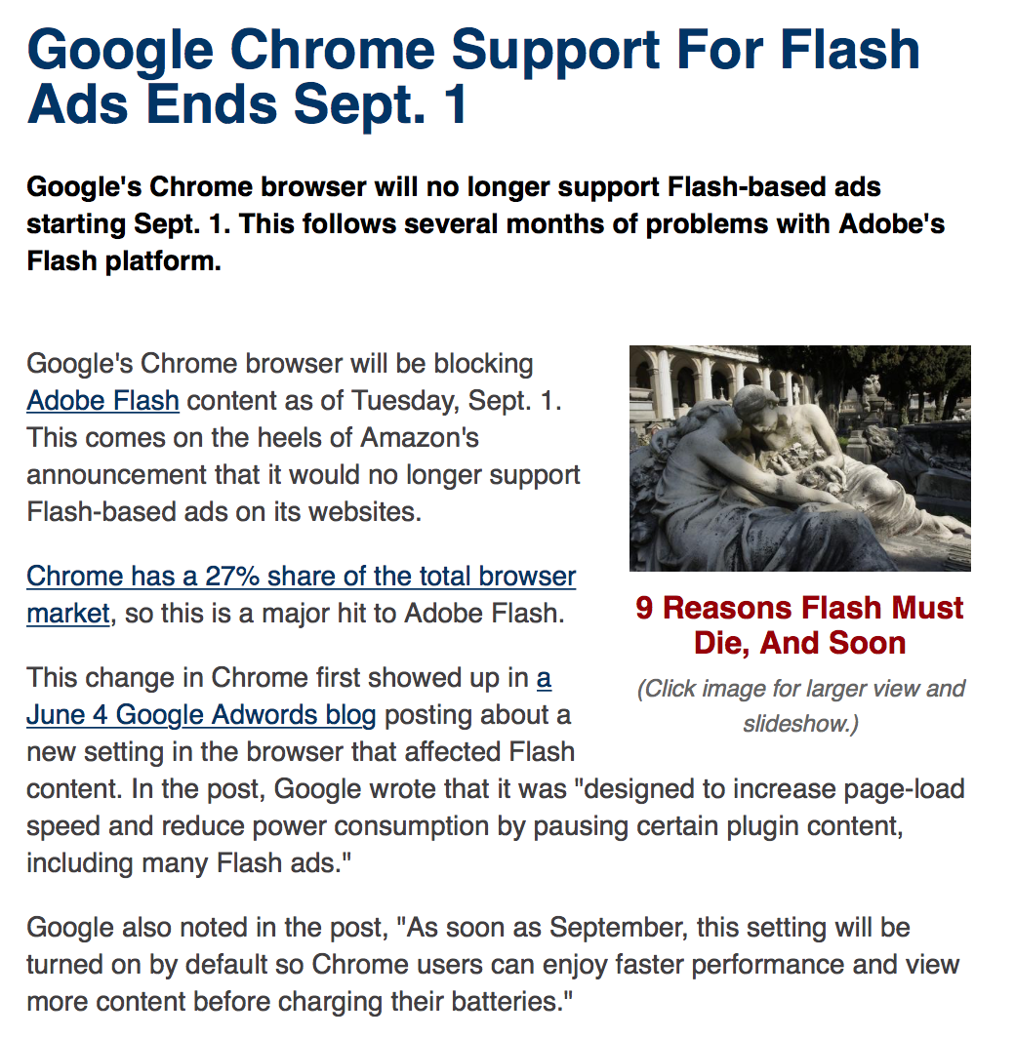
RIP Flash

Slide 5
Panic!
Luckily, we had been planning for this for the past few months
But it did mean that we had to ramp up the work to meet the September 1 deadline

Slide 6
The new Ad environment
We have been working on a new setup that uses:
  An EVLDNS platform to provide dynamic DNS authoritative server support*
  An inspired NGINX web server config that can generate and support dynamic URLs over TLS (GGM – take a bow!)
  Certs on the domain names to allow HTTPS support
  Linode VM measurement hosts (adding Singapore to the mix)
  An HTML5 Ad platform
We started testing this configuration in July
And switched over our Ad run in August **
* Thanks to Ray Bellis and ISC for their support
** Thanks to Vint Cerf, Warren Kumari and Google for their support

Slide 7


A different View…
From this:

Slide 8

A different View…
To this:

Slide 9
Some Numbers from HTML5 Ad *
1 – 26 October 2015: 224,778,841 samples (avg 8.6M samples per day)
OS % Count
Win7 40.87 91,861,206
Android 15.12 33,997,634
iOS 12.55 28,198,792
Win8.1 8.93 20,076,610
WinXP 8.66 19,469,245
WinNT 5.67 12,744,058
Mac OS X 3.65 8,201,719
Win8.0 2.27 5,109,002
Linux 1.00 2,243,873
WinVista 0.65 1,470,365
Windows Phone 0.44 980,570
Chrome OS 0.11 241,238
* These are “raw” unweighted numbers

Slide 10
Some Numbers from HTML5 Ad *
1 – 26 October 2015: 224,778,841 samples (8.6M per day)
OS % Count
Win7 40.87 91,861,206
Android 15.12 33,997,634
iOS 12.55 28,198,792
Win8.1 8.93 20,076,610
WinXP 8.66 19,469,245
WinNT 5.67 12,744,058
Mac OS X 3.65 8,201,719
Win8.0 2.27 5,109,002
Linux 1.00 2,243,873
WinVista 0.65 1,470,365
Windows Phone 0.44 980,570
Chrome OS 0.11 241,238
38% of samples are from mobile devices
* These are “raw” unweighted numbers

Slide 11
Browser Share *
Browser % Count
Chrome 61.44 138,094,601
Safari 17.40 39,117,203
Firefox 11.97 26,915,412
MSIE 4.45 10,000,533
Mobile_Safari 2.47 5,558,215
Opera 2.10 4,726,655
Chromium 0.10 216,915
Silk 0.04 94,382
Netscape 0.00 2,885
* These are “raw” unweighted numbers

Slide 12
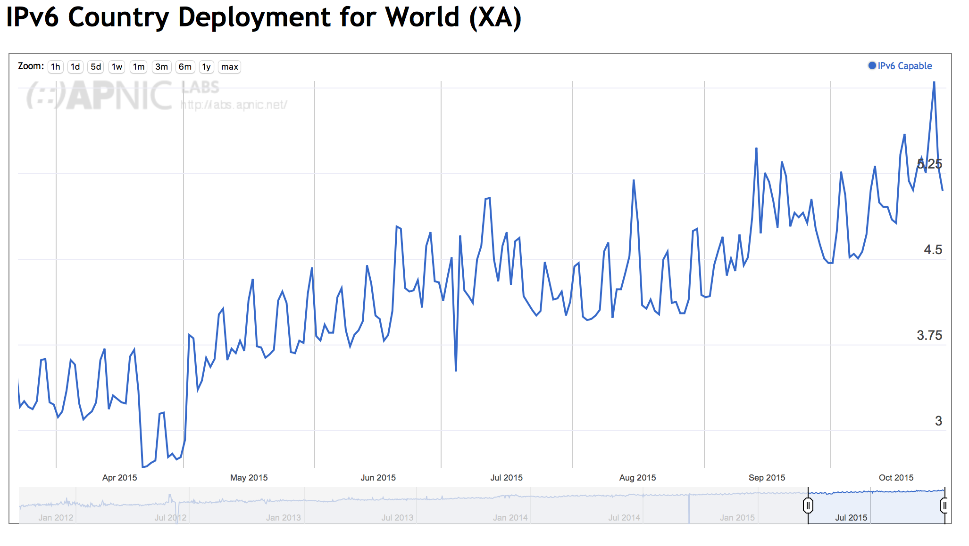
IPv6 Measurement

Slide 13
IPv6 Measurement
This is probably measurement-related
As is this!

Slide 14
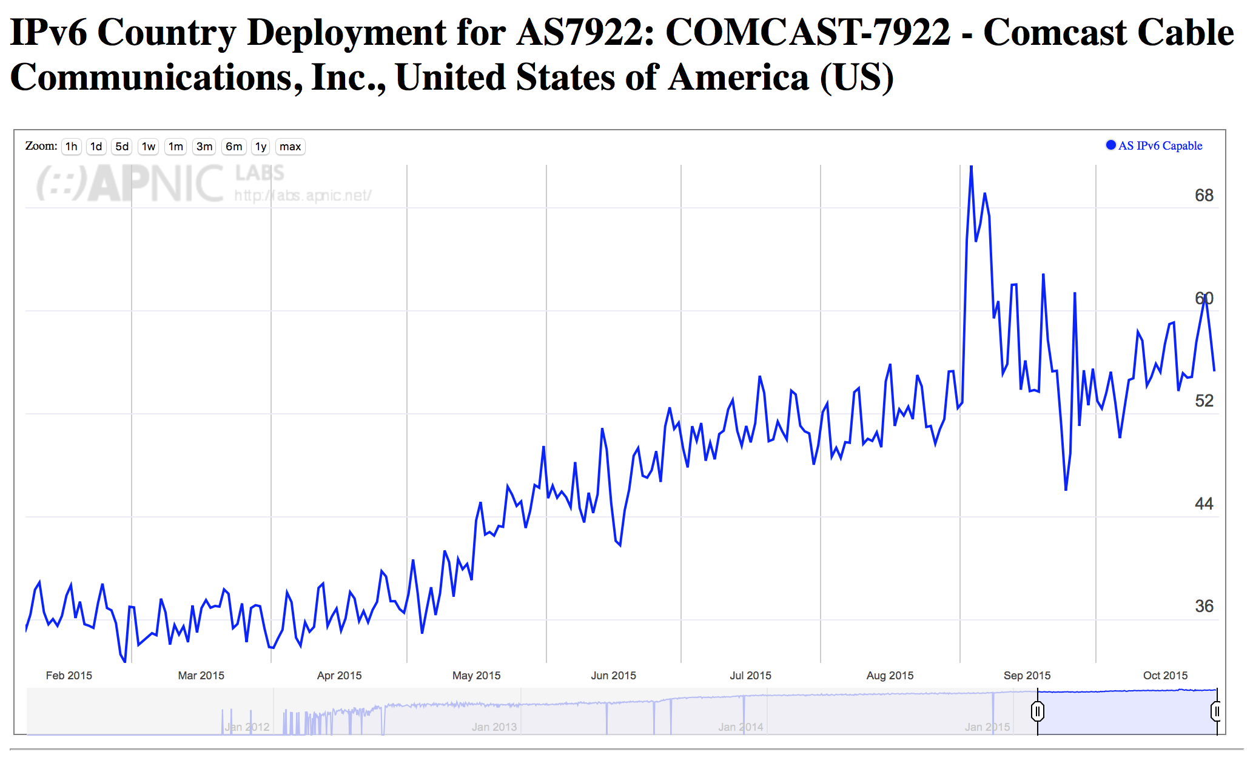
IPv6 Measurement
As is this!

Slide 15
Where to now
We already measure IPv6 deployment by country and by network:
  http://stats.labs.apnic.net/ipv6
Over the coming months we want to:
  Fix up gelocation of networks
    (the “Liberty Global” case)
  Break out the numbers to give fixed / mobile by country
  HTTP / HTTPS breakdowns
  Browser share over time
  Measure IPv6 performance and brokenness in a structured manner

Slide 16
That’s it!

